Slide 1
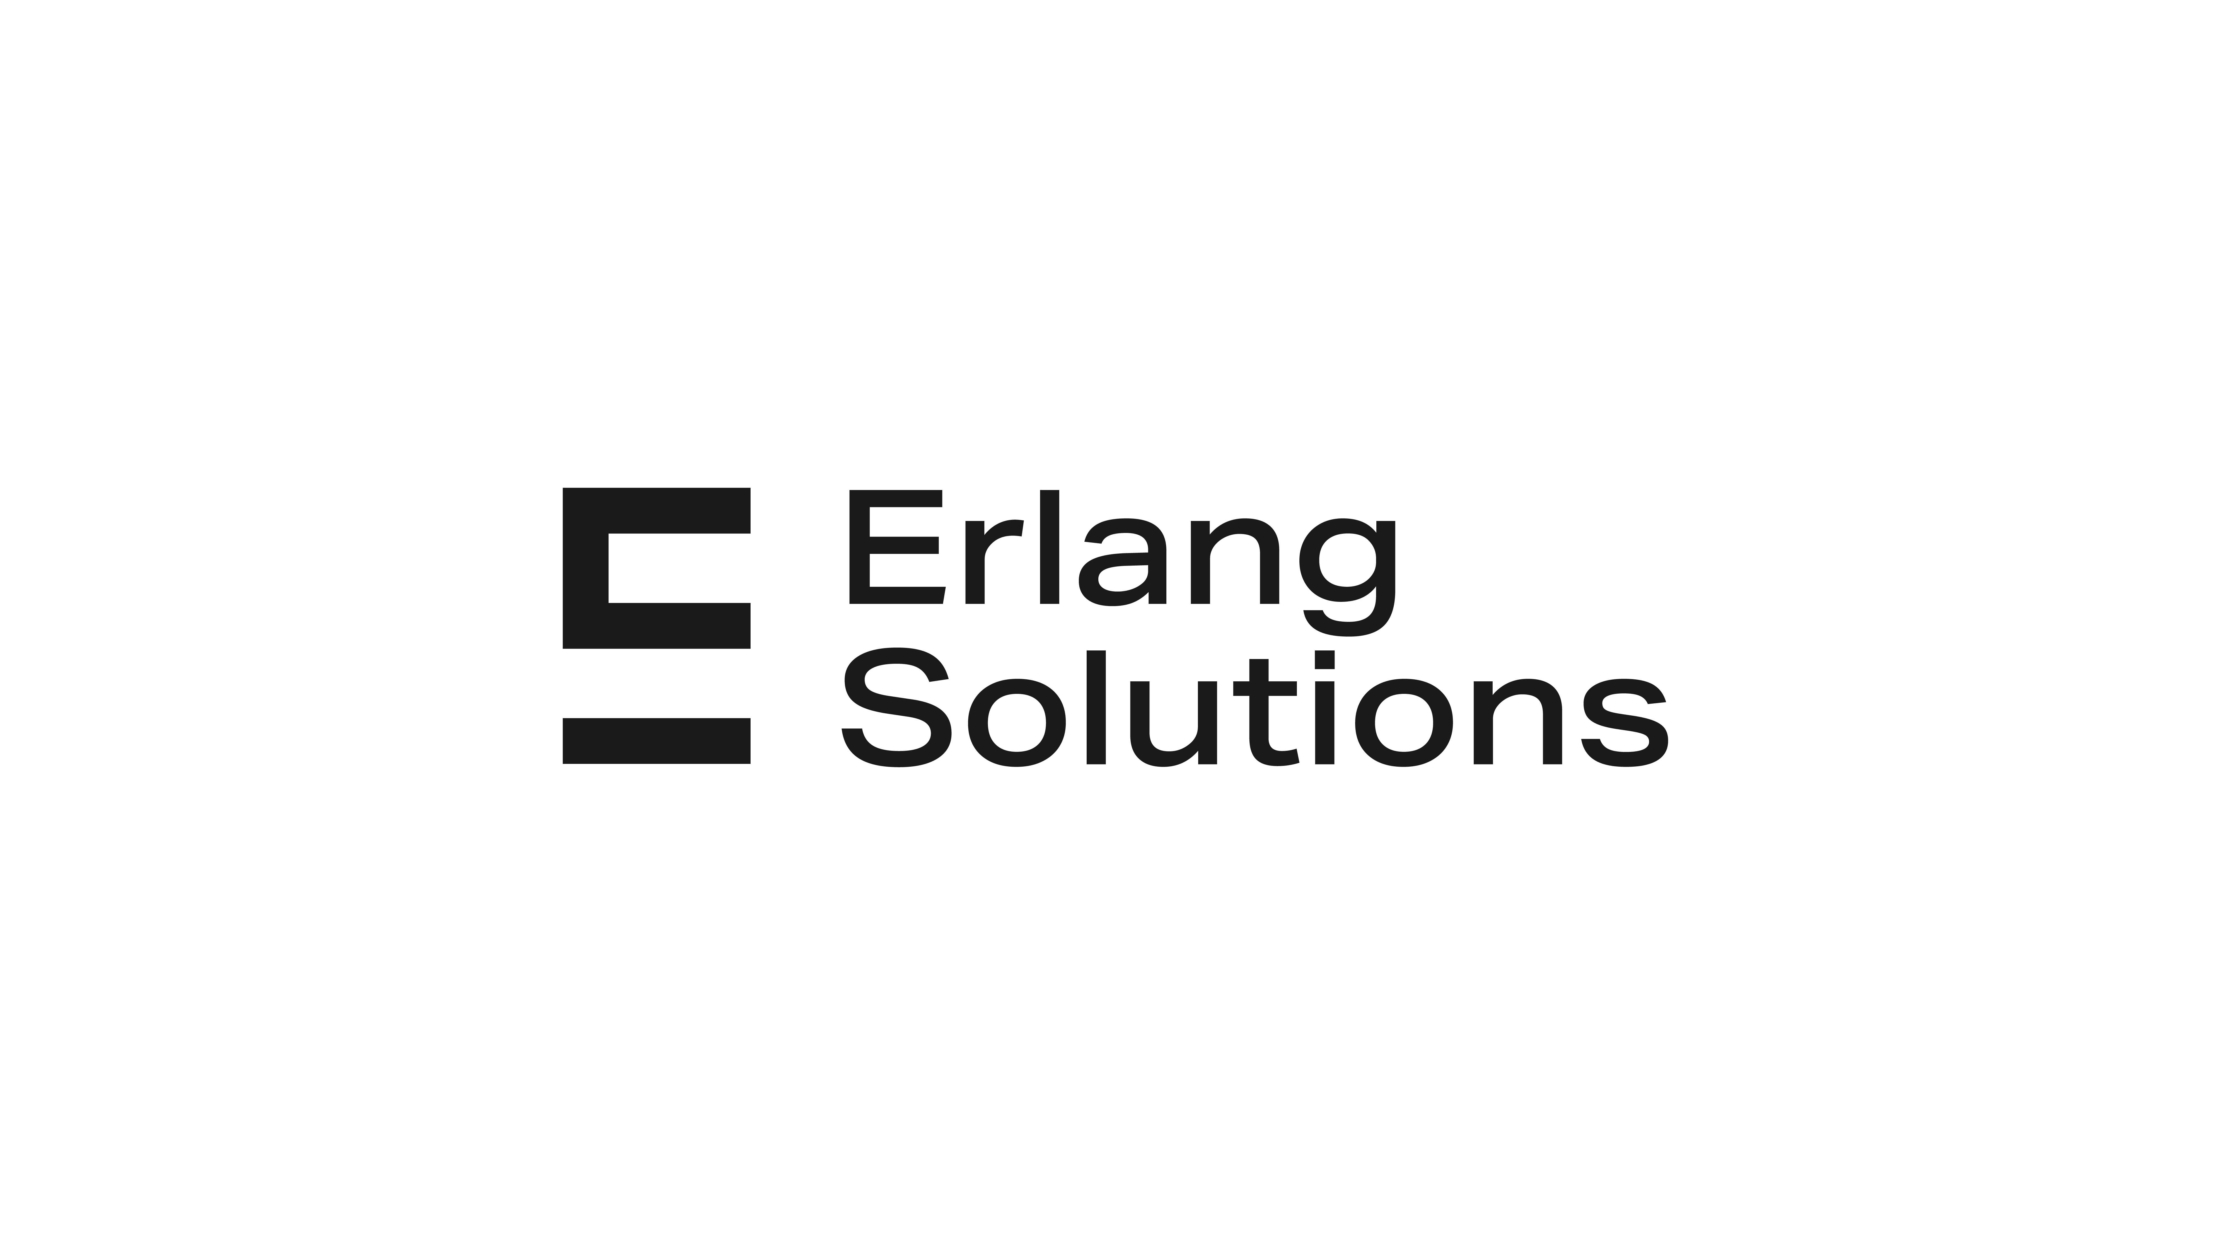
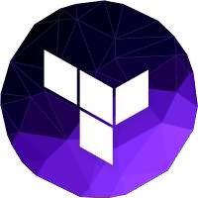
Infrastructure as Code with
Terraform
11/2023

Slide 2
We created a static website using Terraform last week
Create content for our static website
Setting up Terraform and AWS resources: policy, website configuration, provider, …
Setting the output for our website’s domain in terminal
Lastly, access the hosted static website.

Slide 3
What we will have in the 4th part:
Host a static website with S3 – 1st meeting (DONE)
Create AWS Virtual Private Cloud with Terraform – 2nd meeting
Deploying a Multi-Tier Web Application – 3rd

Slide 4
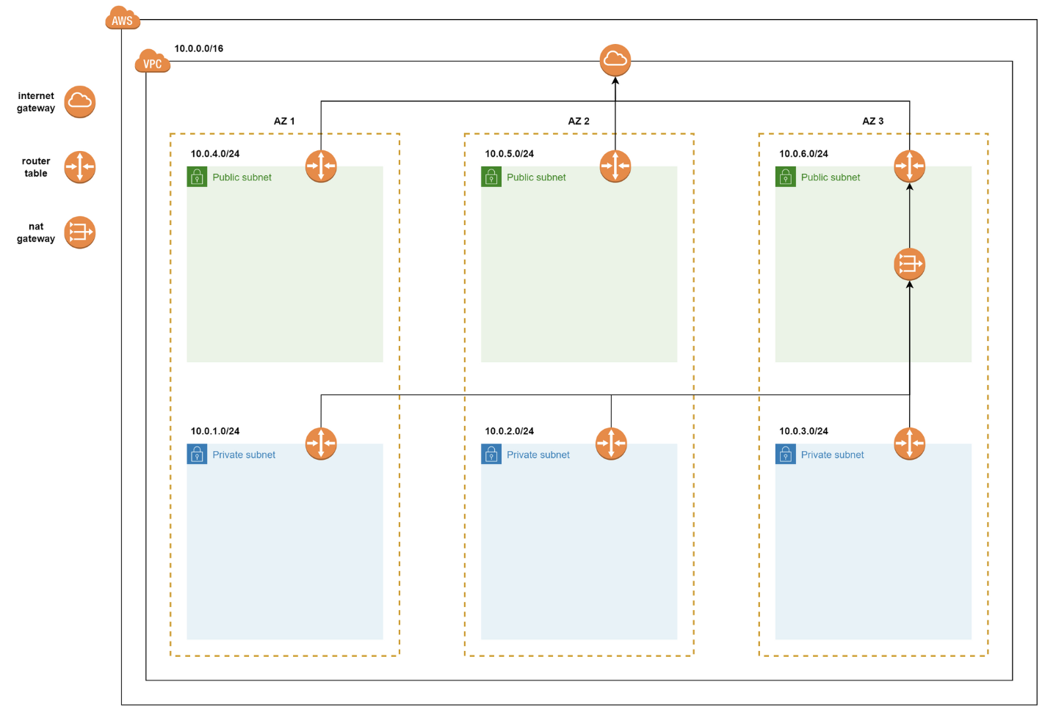
Part 2
Create AWS Virtual Private Cloud with Terraform
Notes:
The whole setup of any online service that uses the cloud relies on something called a virtual private cloud (VPC). These VPCs from AWS help keep different parts of the network separate and secure. They handle things like subnets, routing, firewalls, and DHCP.
Designing and planning how the cloud network should work is a big area that needs knowledge about how networks function. Luckily, AWS makes it easier by giving us simpler ways to deal with all the technical stuff in the background.
Today, we'll talk about creating a basic AWS VPC using Terraform.

Slide 5
Steps create an AWS VPC with Terraform:
Create a VPC
Create Subnets
Setting up the Internet Gateway
Setting up NAT Gateway

Slide 6
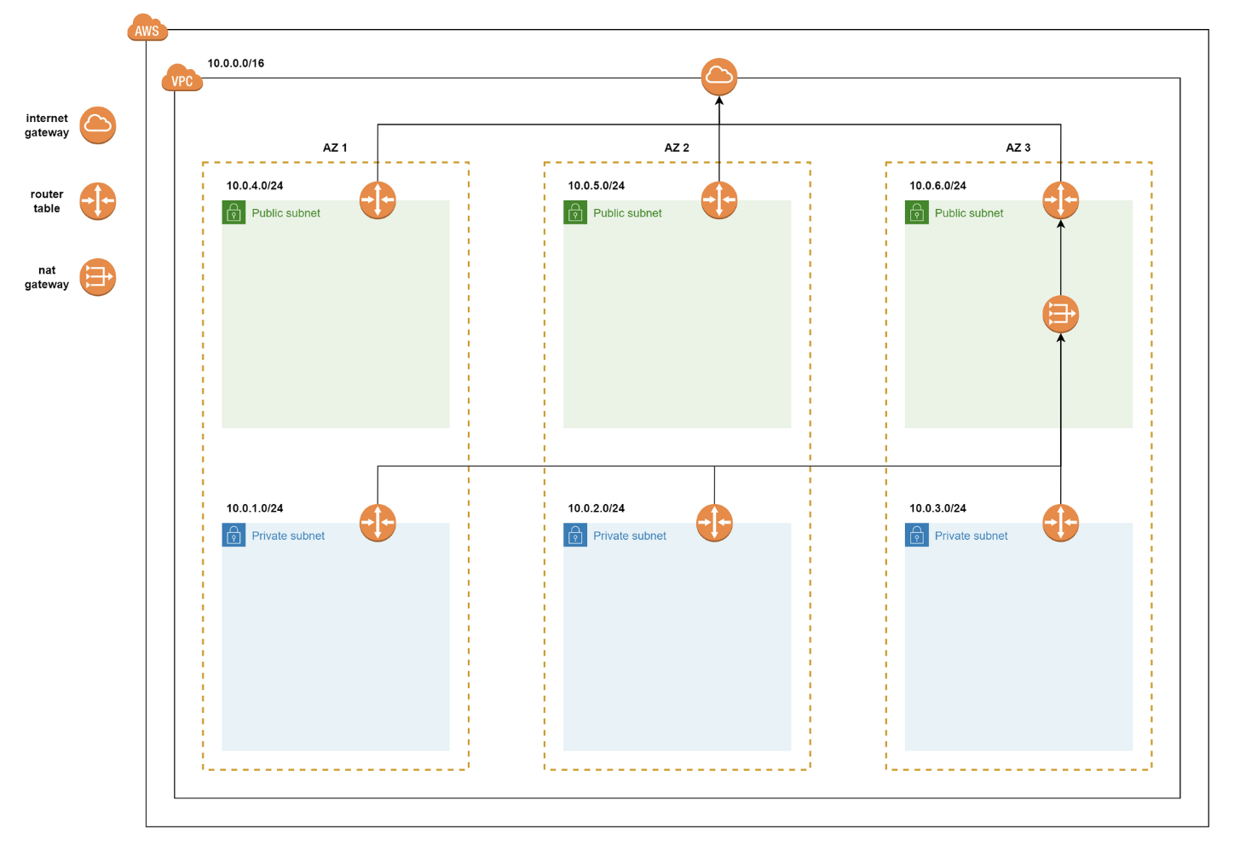
The infrastructure that we will build today is illustrated as below:
Notes:
There are several considerations to be made while building a VPC for any project. Let’s start to build our VPC from the ground up using Terraform.
The image above represents a basic target VPC design that consists of the following components:
1 Internet Gateway
1 NAT gateway
3. 3 Public Subnets, one in each AZ
4. 3 Private Subnets, one in each AZ
5. Route Table configurations
A VPC spans all the Availability Zones (AZ) in a region. It is always associated with a CIDR range
Classless Inter-Domain Routing (CIDR) is an IP address allocation method that improves data routing efficiency on the internet.
CIDR allows routers to organize IP addresses into multiple subnets more efficiently. A subnet is a smaller network that exists within a network. For example, all devices connected to a router are on the same subnet and have the same IP address prefix

Slide 7
AWS Virtual Private Cloud

Slide 8
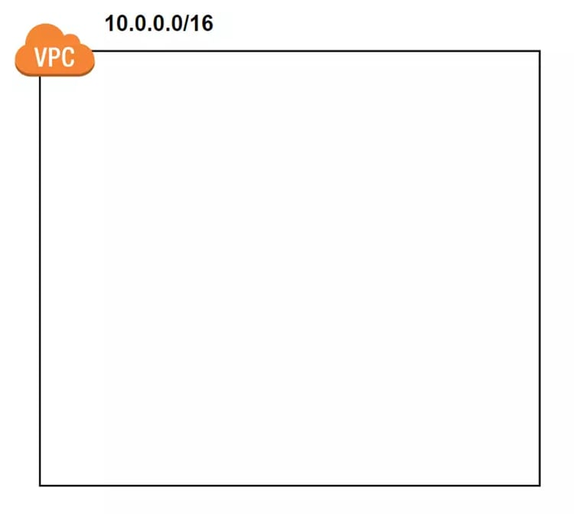
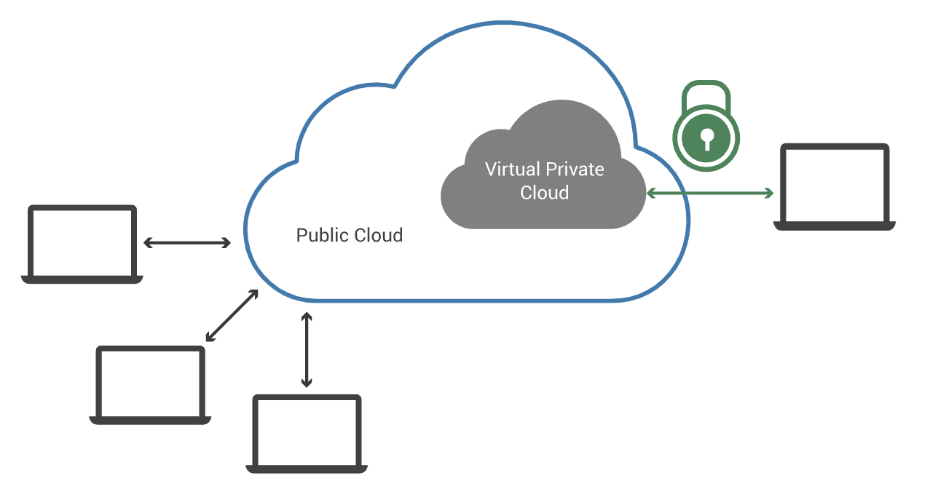
A virtual private cloud (VPC) is a secure, isolated private cloud hosted within a public cloud.
Reference link: https://www.cloudflare.com/en-gb/learning/cloud/what-is-a-virtual-private-cloud/

Slide 9

The benefits of using a Virtual Private Cloud (VPC) in AWS include:
Isolation and Security: Create a private, secure environment.
Custom Networking: Control IP address range, subnets, and network configurations.
Subnet Division: Distribute resources across multiple Availability Zones for fault tolerance.
Internet and Hybrid Connectivity: Connect to the internet and establish hybrid cloud connections.
Security Groups and Network ACLs: Fine-grained control over traffic at instance and subnet levels.
Elastic Load Balancing: Seamless integration for distributing incoming application traffic.
Scalability: Easily scale infrastructure up or down based on dynamic needs.
Resource Visibility and Monitoring: Tools like CloudWatch, Config, and CloudTrail for monitoring and auditing.
Global Reach: VPC peering enables connection across different AWS regions.

Slide 10
Step 1: Create a VPC
To begin with, let’s start by defining our VPC resource in Terraform.
To specify a range of IP addresses in a VPC, a CIDR block needs to be provided.
We have also provided a Name tag for identification.
resource "aws_vpc" "vpc" {
cidr_block = "10.0.0.0/16"
tags = {
"Name" = "custom"
}
}
Above we will create a new VPC with CIDR of 10.0.0.0/16 and name custom
Notes:
CIDR (Classless Inter-Domain Routing) wiki: https://en.wikipedia.org/wiki/Classless_Inter-Domain_Routing
CIDR của VPC sẽ có các giá trị nằm trong khoảng sau:
10.0.0.0/16 -> 10.0.0.0/28
172.16.0.0/16 -> 172.16.0.0/28
192.168.0.0/16 -> 192.168.0.0/28

Slide 11
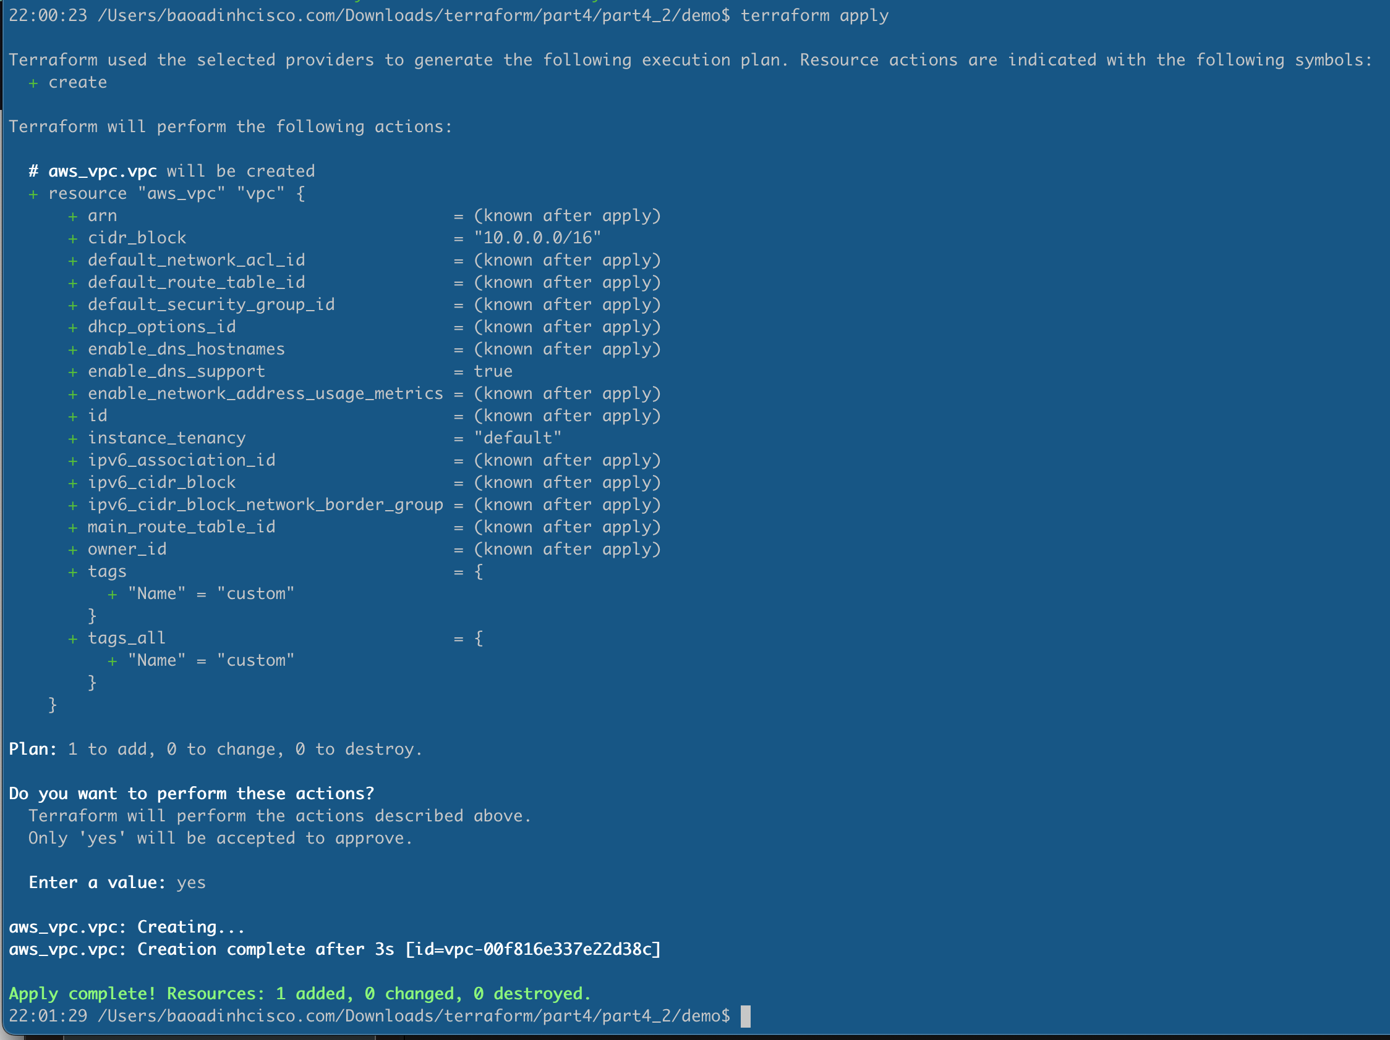
By applying this configuration, we have our VPC is ready.

Slide 12
Create Subnets

Slide 13
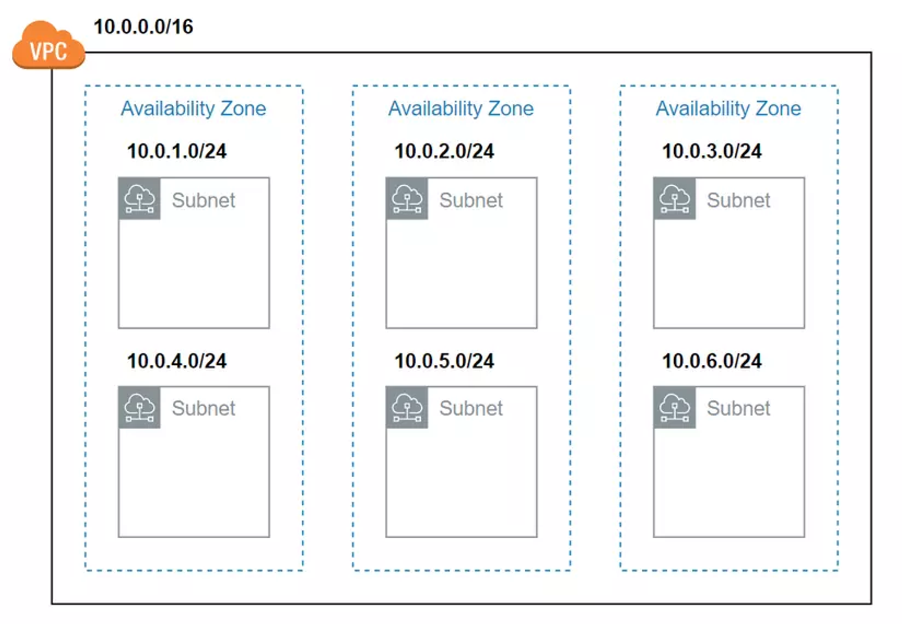
Publish Subnet
Publish Subnet
Publish Subnet
Private Subnet
Private Subnet
Private Subnet
Notes:
In the VPC, we make sub-areas called subnets, and each of them is tied to a specific Availability Zone (AZ). It's even okay to have more than one subnet in the same AZ. Subnets help keep things separated inside the VPC, especially in each AZ. AWS Regions have different AZs, which is handy for disaster recovery planning

Slide 14
To create subnets we use aws_subnet resource
resource "aws_subnet" "private_subnet_2a" {
vpc_id = aws_vpc.vpc.id
cidr_block = "10.0.1.0/24"
availability_zone = "us-west-2a"
tags = { "Name" = "private-subnet" }
}
If we need more Subnets, we can copy another resource, but that will create quite long code,
we can shorten the code as the next slide..
Notes:
If we need more Subnets, we can copy another resource, but that will create quite long code, we can shorten the code as follows. In the demo today, we will create 3 private subnets and 3 publish subnets.

Slide 15
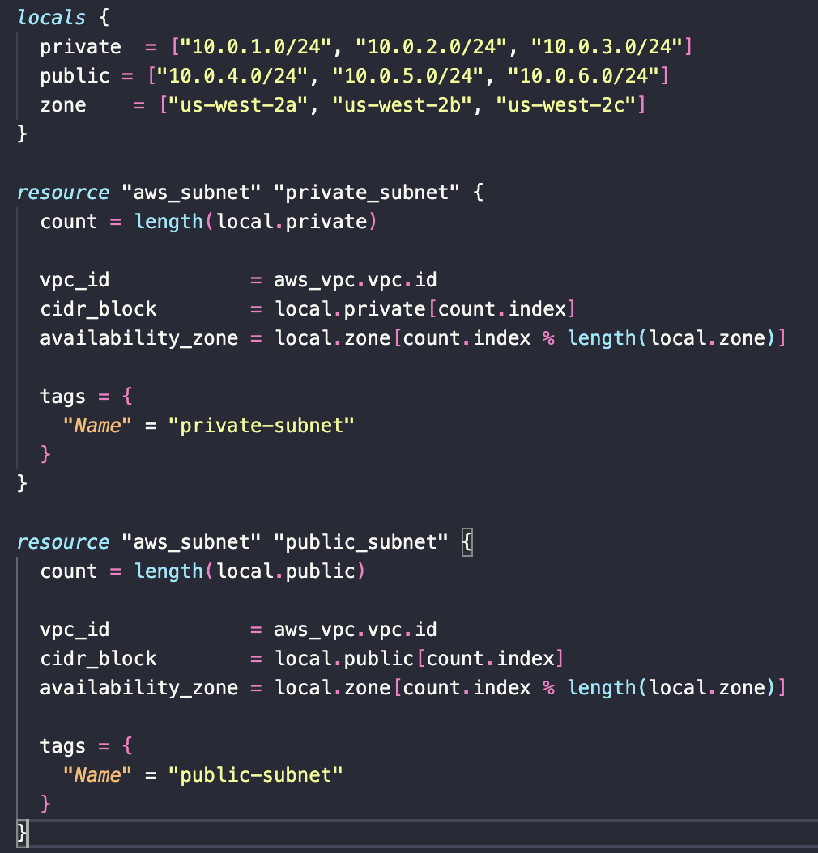
Notes:
Local block: This block defines three local variables:
private: A list of CIDR blocks for private subnets.
public: A list of CIDR blocks for public subnets.
zone: A list of availability zones.
Private Subnets Count and Index:
The count attribute specifies the number of instances of the resource to create. In this case, it's set to the length of the local.private list, so Terraform will create a subnet for each CIDR block in local.private.
VPC-ID:
This sets the vpc_id attribute of the subnet to the ID of the VPC.
CIDR Block for Subnets: count.index refers to the current index of the resource being created. It's used to select the corresponding CIDR block from the local.private list. Zone: This line determines the availability zone for each subnet. count.index % length(local.zone) calculates the remainder of the division of the current index by the length of the local.zone list. This is a way to cycle through the availability zones as the index increases. For instance, if there are 4 availability zones, the sequence would be "us-west-2a", "us-west-2b", "us-west-2c", "us-west-2a", and so on.
Tags are added to each subnet for identification purposes. In this case, a "Name" tag is set to "private-subnet".

Slide 16
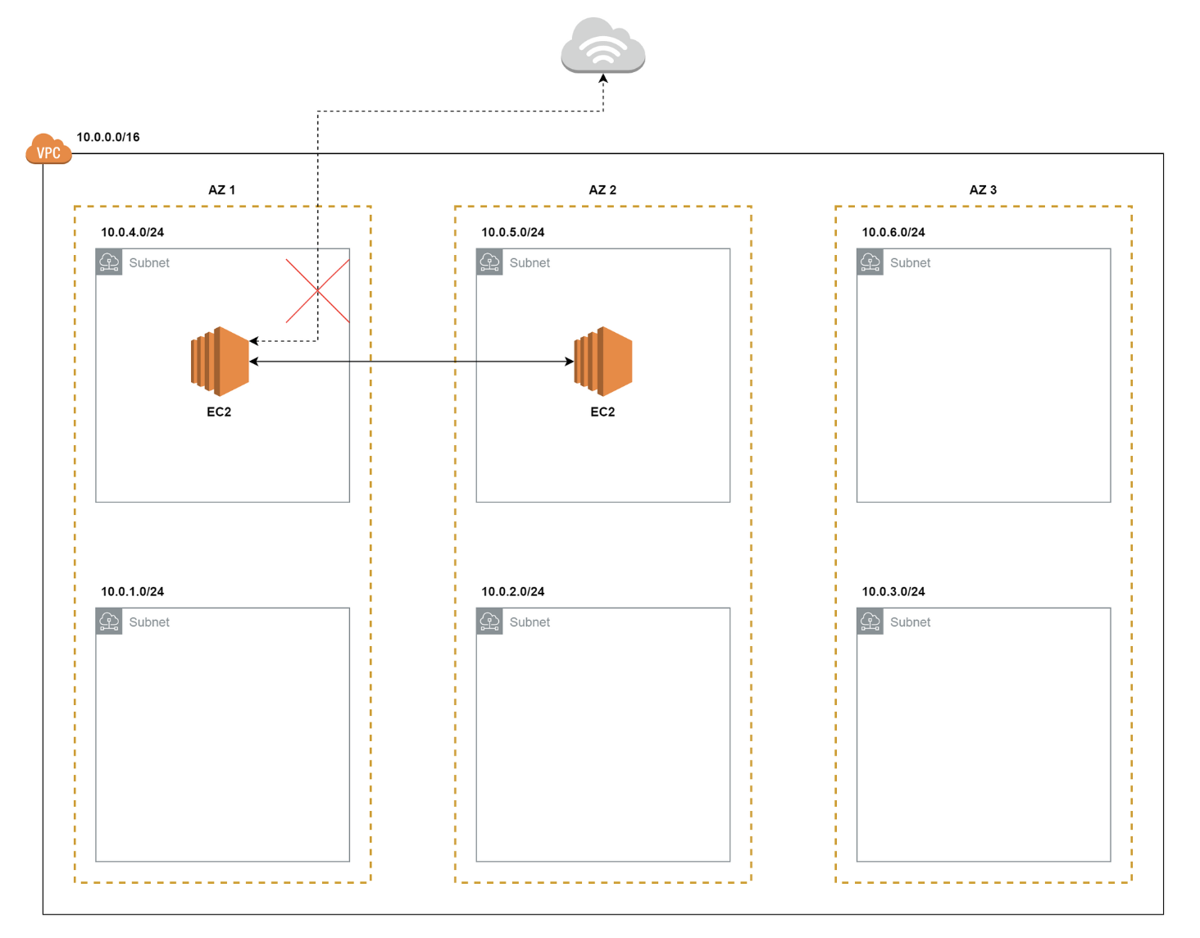
Notes:
Once we've set up our AWS services within these sub-areas, they can communicate internally. However, if these services want to communicate with entities outside the internet or vice versa, there's an issue. That's because we don't have something acting as a router to facilitate communication between our AWS services and the internet. Since we have to build public subnets, we need to provide access to the internet in the given VPC. For this, the first thing that we need is an internet gateway.
And we will assign this IG to the Route Table

Slide 17
Let’s create Internet Gateway

Slide 18
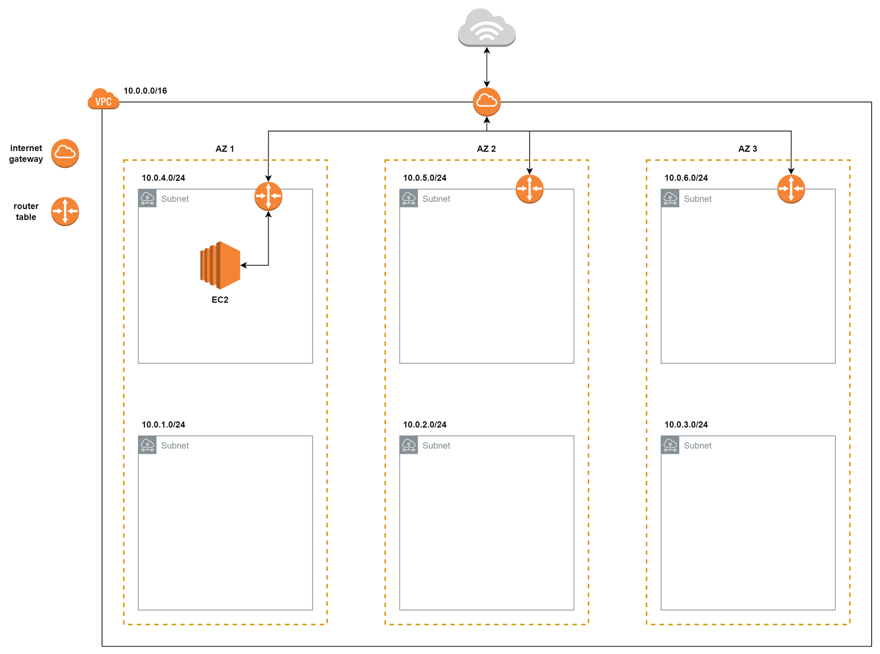
Publish Subnet
Publish Subnet
Publish Subnet
Private Subnet
Private Subnet
Private Subnet
Notes:
When a VPC is created, a corresponding Route Table is also created, which defines a default route that lets the components in the VPC communicate with each other internally.
In our system design, we have two kinds of sub-areas: public and private subnets. Public subnets let the things inside them connect to the internet, while private ones don't. The routes in the route tables decide whether internet access is on or off. If a subnet is linked to a route table that permits internet access, we call it a public subnet. On the other hand, if it's associated with a route table that blocks internet access, it's a private subnet.

Slide 19
The resource block below is the simplest way to create an internet gateway.
resource "aws_internet_gateway" "ig" {
vpc_id = aws_vpc.vpc.id
tags = { "Name" = "custom" }
}
Assign IG to Route Table:
resource "aws_internet_gateway" "ig" {
vpc_id = aws_vpc.vpc.id
tags = { "Name" = "custom" }
}
resource "aws_route_table" "public" {
vpc_id = aws_vpc.vpc.id
route {
cidr_block = "0.0.0.0/0”
gateway_id = aws_internet_gateway.ig.id }
tags = { "Name" = "public" }
}

Slide 20
Assign Route Table for Subnet.
resource "aws_route_table_association" "public_association" {
for_each = { for k, v in aws_subnet.public_subnet : k => v }
subnet_id = each.value.id
route_table_id = aws_route_table.public.id
}
Notes:
In summary, this Terraform code is associating each public subnet with a specific route table. The use of for_each ensures that each association is unique, and the association is created for each public subnet in the specified route table.

Slide 21
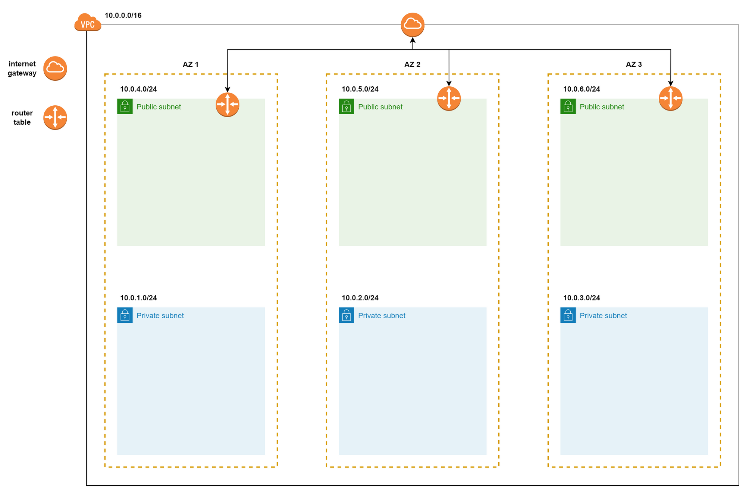
Notes:
Now that our Services inside the Public Subnet can interact with the outside, what about the Private Subnets?
At the moment, the services in the private subnet can't talk to the internet. We can't assign an Internet Gateway (IG) to the private subnet because the IG works both ways — in and out. However, we only want communication to go one way: from the private subnet to the outside, not the other way around.

Slide 22
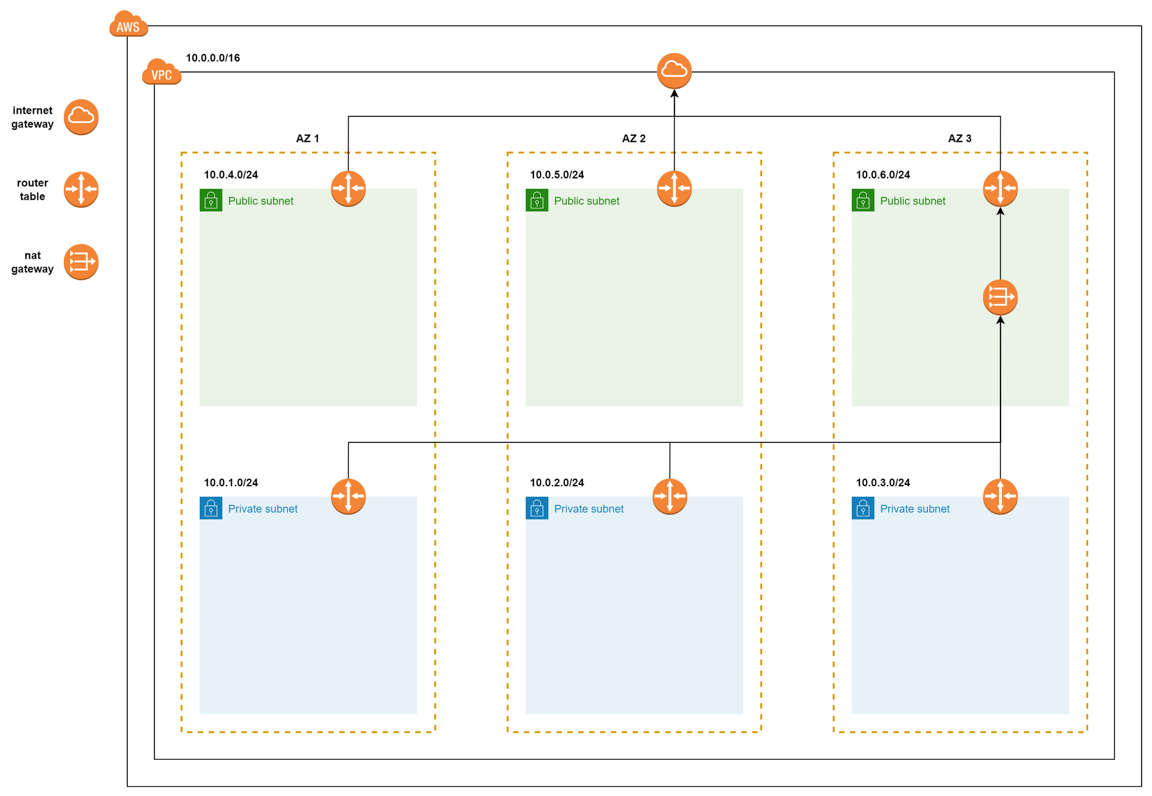
Notes:
To make this happen, we'll use a Network Address Translation (NAT) setup. We'll deploy NAT on a public subnet, link it to the route table, and then assign that route table to the private subnets. This way, the NAT setup in the public subnet will act as the go-between, allowing communication from the private subnets to the outside world while keeping the private subnets secure.

Slide 23
We use aws_nat_gateway resource to create NAT.
Provides an Elastic IP resource.
resource "aws_eip" "nat" {
vpc = true
}
resource "aws_nat_gateway" "public" {
depends_on = [aws_internet_gateway.ig]
allocation_id = aws_eip.nat.id
subnet_id = aws_subnet.public_subnet[0].id
tags = { Name = "Public NAT" }
}
Notes:
Elastic IP (aws_eip):
This block creates an Elastic IP (EIP) resource named "nat".
vpc = true specifies that the Elastic IP should be associated with a Virtual Private Cloud (VPC). In AWS, Elastic IPs are used to provide a static public IP address to AWS resources, and in this case, it's used for the NAT Gateway. NAT Gateway (aws_nat_gateway):
This block creates a NAT Gateway resource named "public".
depends_on = [aws_internet_gateway.ig] specifies that the creation of the NAT Gateway depends on the completion of the creation of the specified Internet Gateway (aws_internet_gateway.ig). This ensures that the Internet Gateway is created before attempting to create the NAT Gateway.
allocation_id = aws_eip.nat.id associates the NAT Gateway with the Elastic IP created earlier. It uses the ID of the Elastic IP (aws_eip.nat.id) for this association.
subnet_id = aws_subnet.public_subnet[0].id specifies the subnet in which the NAT Gateway should be deployed. It uses the ID of the first public subnet (aws_subnet.public_subnet[0].id). Note that this assumes there is at least one public subnet defined in the aws_subnet.public_subnet resource.
This aligns with the common pattern of placing NAT Gateways in public subnets to handle outbound traffic for resources in private subnets.

Slide 24
Next, we create Private Route Table and add NAT for it.
resource "aws_route_table" "private" {
vpc_id = aws_vpc.vpc.id
route {
cidr_block = "0.0.0.0/0"
gateway_id = aws_nat_gateway.public.id }
tags = { "Name" = "private" }
}

Slide 25
Assign Route Table to Private Subnets.
resource "aws_route_table_association" "public_private" {
for_each = { for k, v in aws_subnet.private_subnet : k => v }
subnet_id = each.value.id route_table_id = aws_route_table.private.id
}

Slide 26
Time Apply everything ☺

Slide 27
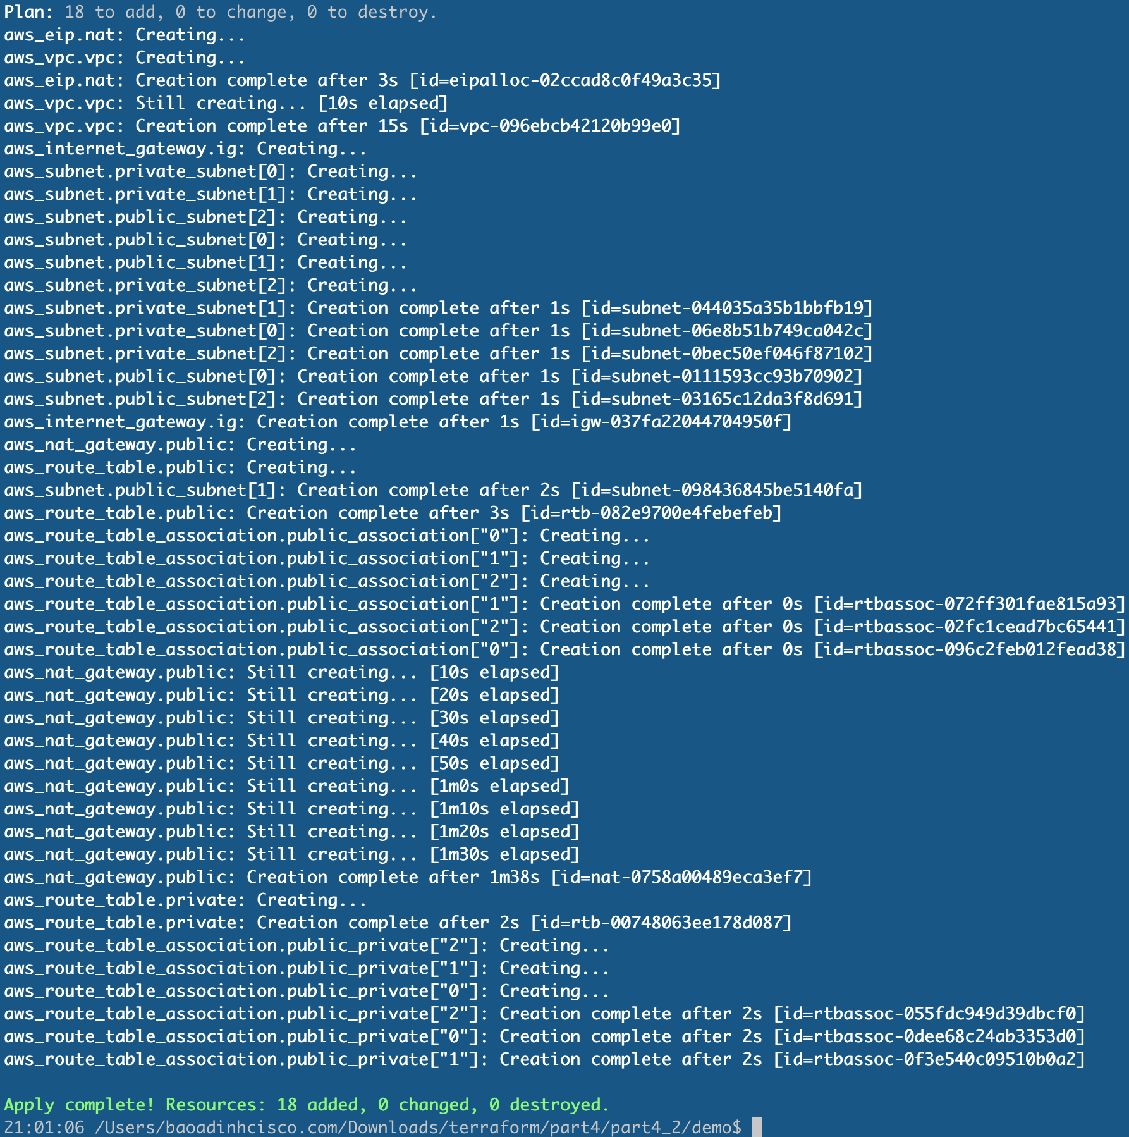
Running terraform apply

Slide 28

Clean up

Slide 29
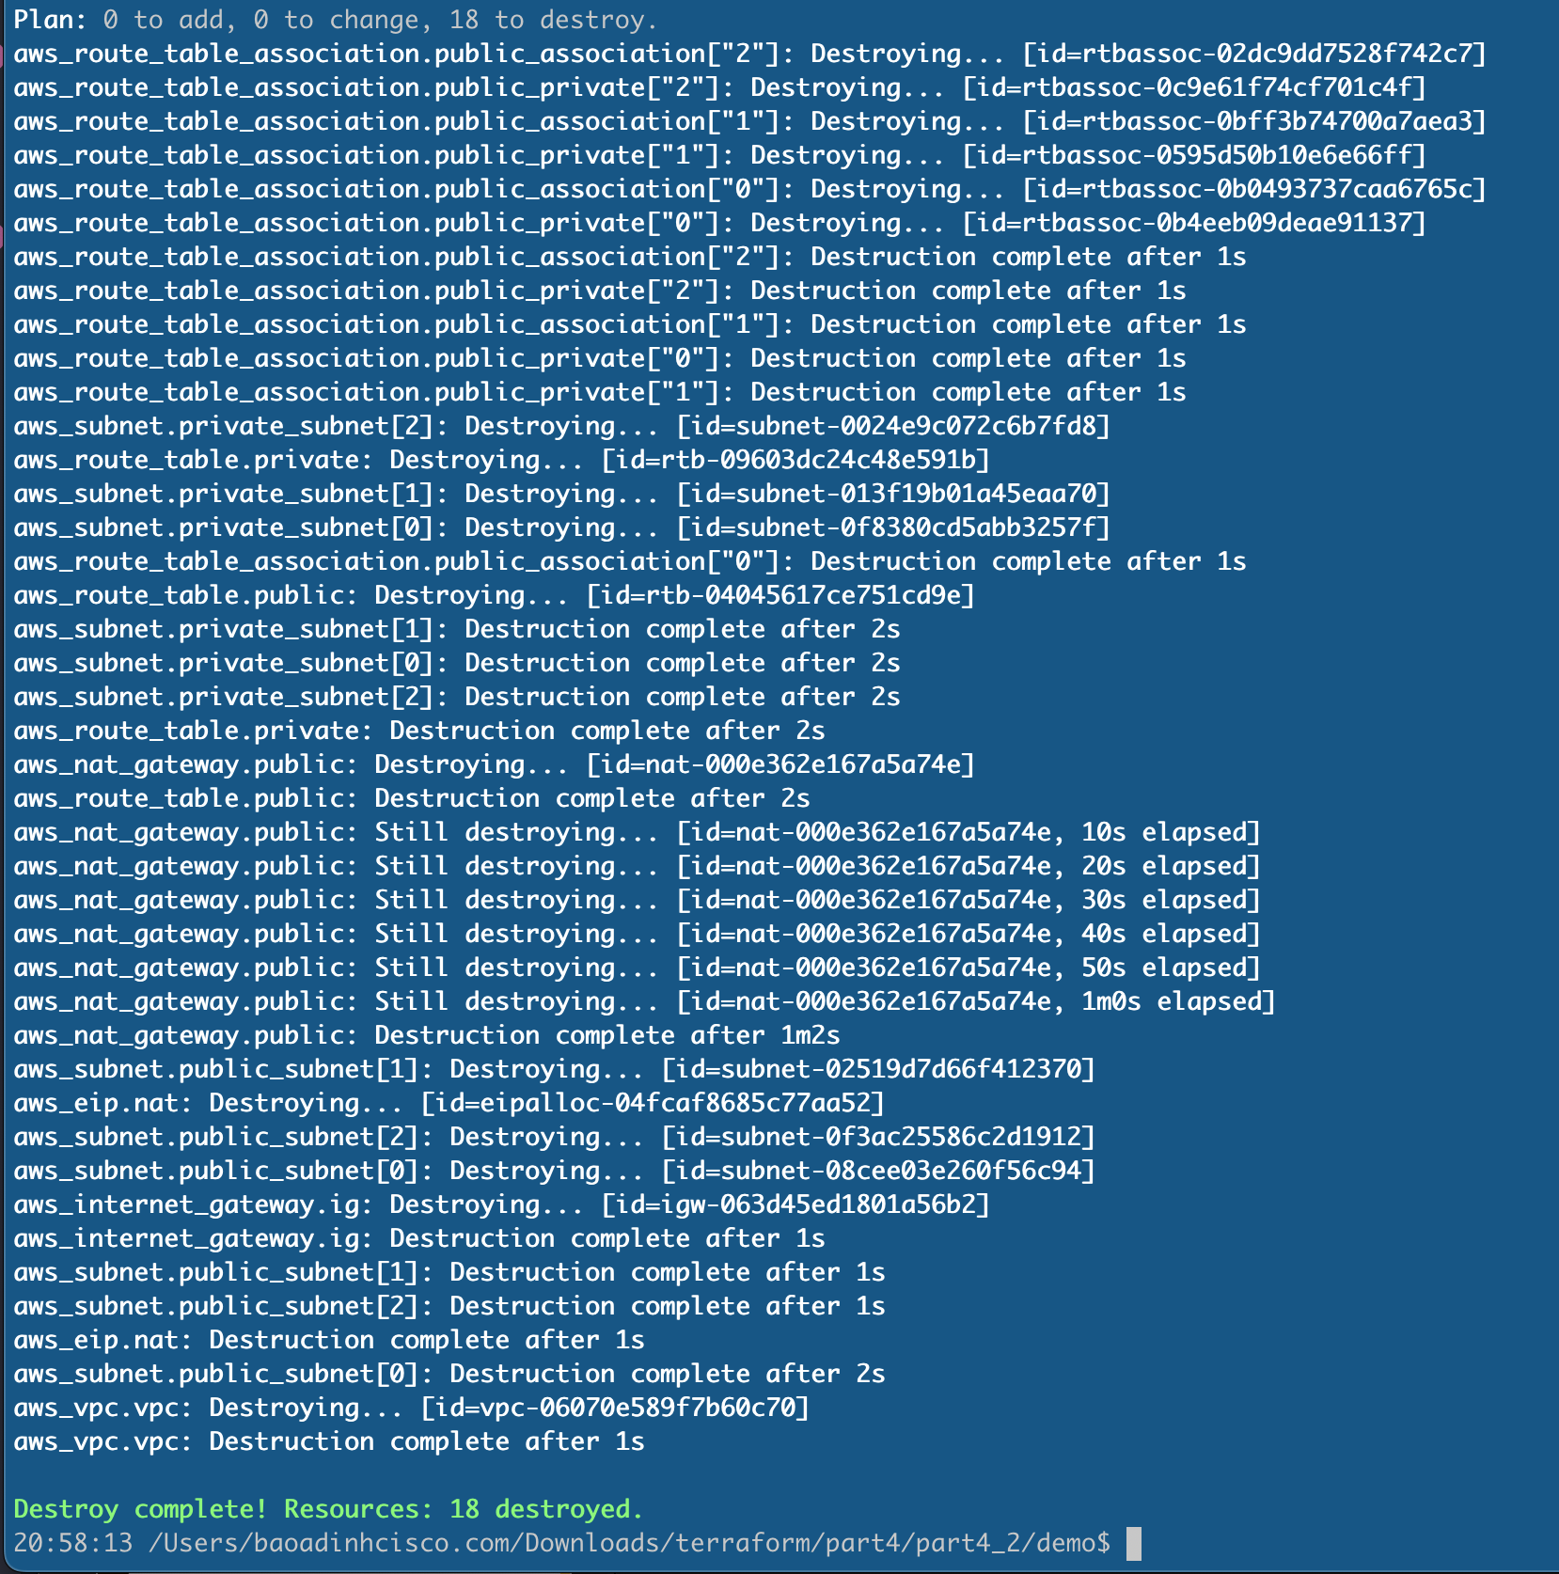
Because AWS resources usually cost money, we might want to remove them after we’re done
with testing. To do that, use the terraform destroy command and confirm with "yes"
Notes:
As we can see, using Terraform to create VPC is quite simple. But every time we want to create another VPC, do we have to copy this code somewhere else? The answer is no! To solve the problem of coding, Terraform provides us with a feature called Module, which helps us organize code into Modules and can be reused many times.

Slide 30
Introduce Terraform Module
Notes:
As we can see, using Terraform to create VPC is quite simple. But every time we want to create another VPC, do we have to copy this code somewhere else? The answer is no! To solve the problem of coding, Terraform provides us with a feature called Module, which helps us organize code into Modules and can be reused many times.

Slide 31
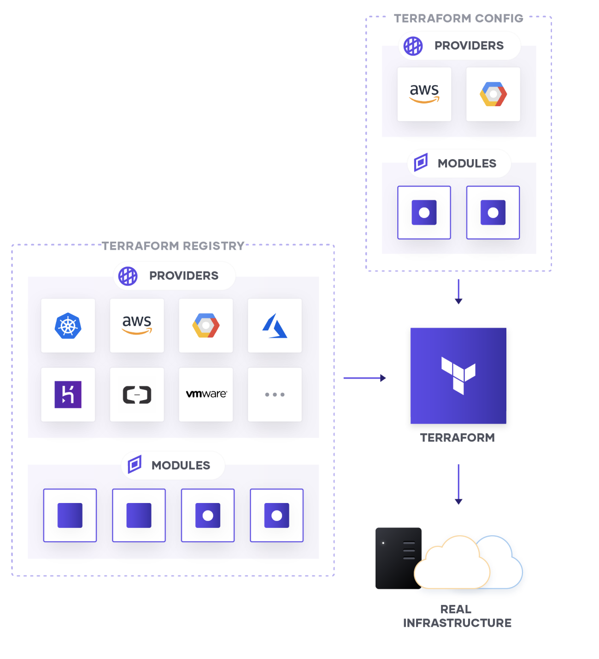
- A Terraform module is a reusable set of Terraform configurations designed for a specific task or resource.
Modules enable you to organize and package infrastructure code in a modular and scalable way.
They promote code reusability and maintainability by encapsulating infrastructure components, making it easy to use the same configuration across different parts of your infrastructure or in multiple projects.

Slide 32
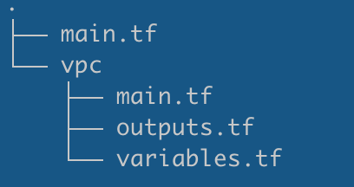
Structure of a Module A basic Module will include the following 3 files:
main.tf: Contains the main configuration for the module.
variables.tf: Defines input variables.
outputs.tf: Defines output values.
Please find the standard module structure here:
https://developer.hashicorp.com/terraform/language/modules/develop#standard-module-structure

Slide 33
Using a Terraform Module:
module <module_name> {
source = <source>
version = <version>
input_one = <input_one>
input_two = <input_two>
}
<source> can be a path under our computer or a path on the network,
<version> specifies the version of the Module,
<input_one><input_two> is the input values ​​we define in the variables.tf file.
Notes:
We use resource name Module

Slide 34
Writing our Terraform Module:
For the example above, the dynamic values ​​we need to pass into our VPC Module are:
vpc_cidr_block
subnet_cidr_block
zone. We will create a directory with the following structure: ├── main.tf (Root module)
└── vpc
├── main.tf
├── outputs.tf
└── variables.tf
The root module is the top-level module.
It’s where user-supplied input variables are configured and where Terraform commands
such as terraform init and terraform apply are run.
Notes:
Now we will refactor our code above into a Module. Before writing the Module, we need to pre-define dynamic values ​​in the Module, so that when we use the Module, we will pass that value in to get different resources.
The purpose is to reuse the vpc configuration under the vpc folder. Next time, If we want to modify the vpc ipaddress for example, we just need to update the top root module.

Slide 35
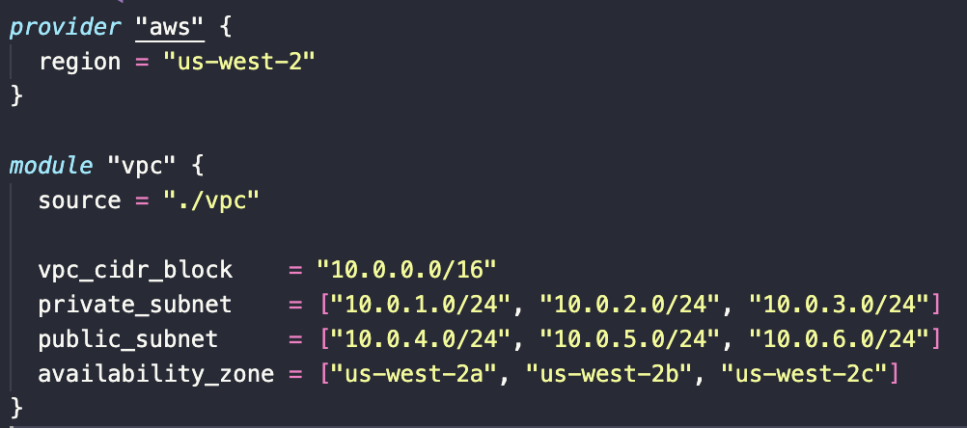
First, we define our main.tf

Slide 36
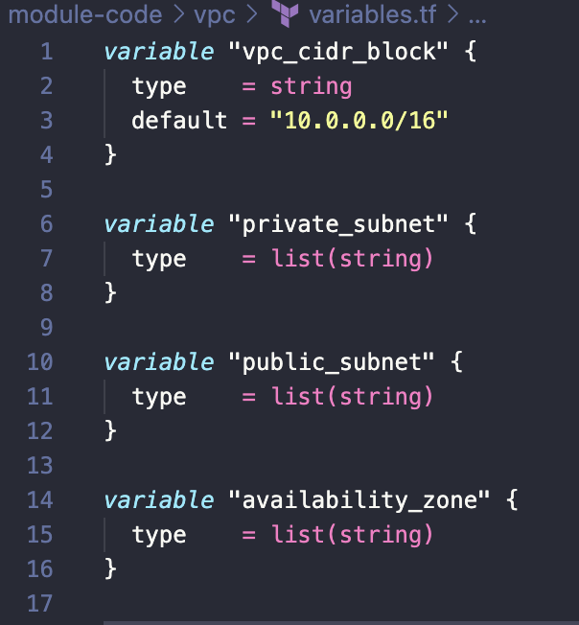
Next, we define the input value of the Module in the vpc/variables.tf file.

Slide 37
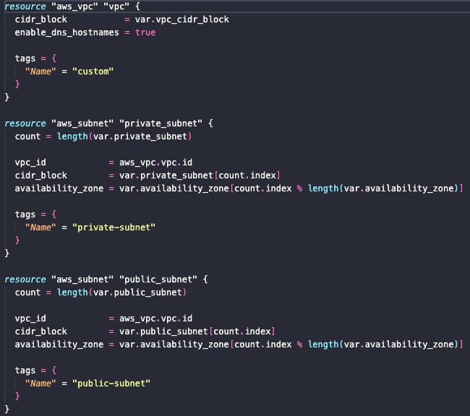
Update for the vpc/main.tf:
(The code here is the same with the example above, we just replace the dynamic values arguments)
Get the value from top root module
Get the value from top root module
For the whole source code, please check in the Github link (TODO)

Slide 38
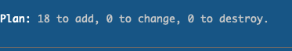
Running terraform plan to verify our code:
Then, let’s apply ☺ (take around 5-10 minutes)

Slide 39
Publish Terraform Module
Notes:
As we can see, using Terraform to create VPC is quite simple. But every time we want to create another VPC, do we have to copy this code somewhere else? The answer is no! To solve the problem of coding, Terraform provides us with a feature called Module, which helps us organize code into Modules and can be reused many times.

Slide 40
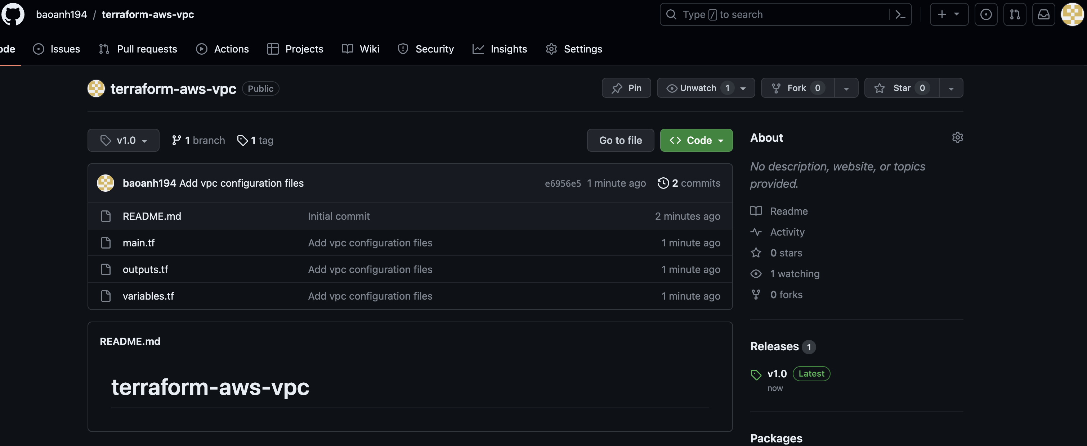
We will publish our Module so everyone can use it.
To do that, we need to
Have a Github account and visit https://registry.terraform.io (login by Github)
Create a Repository in Public status, the name must be in the format
terraform-<PROVIDER>-<NAME>
Copy 3 files in the vpc folder and upload to our new Github Repo.

Slide 41
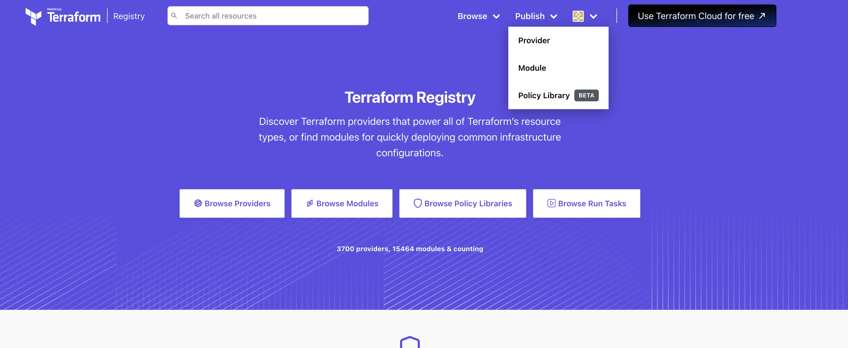
Access to the https://registry.terraform.io/
Choose option Publish -> Module

Slide 42
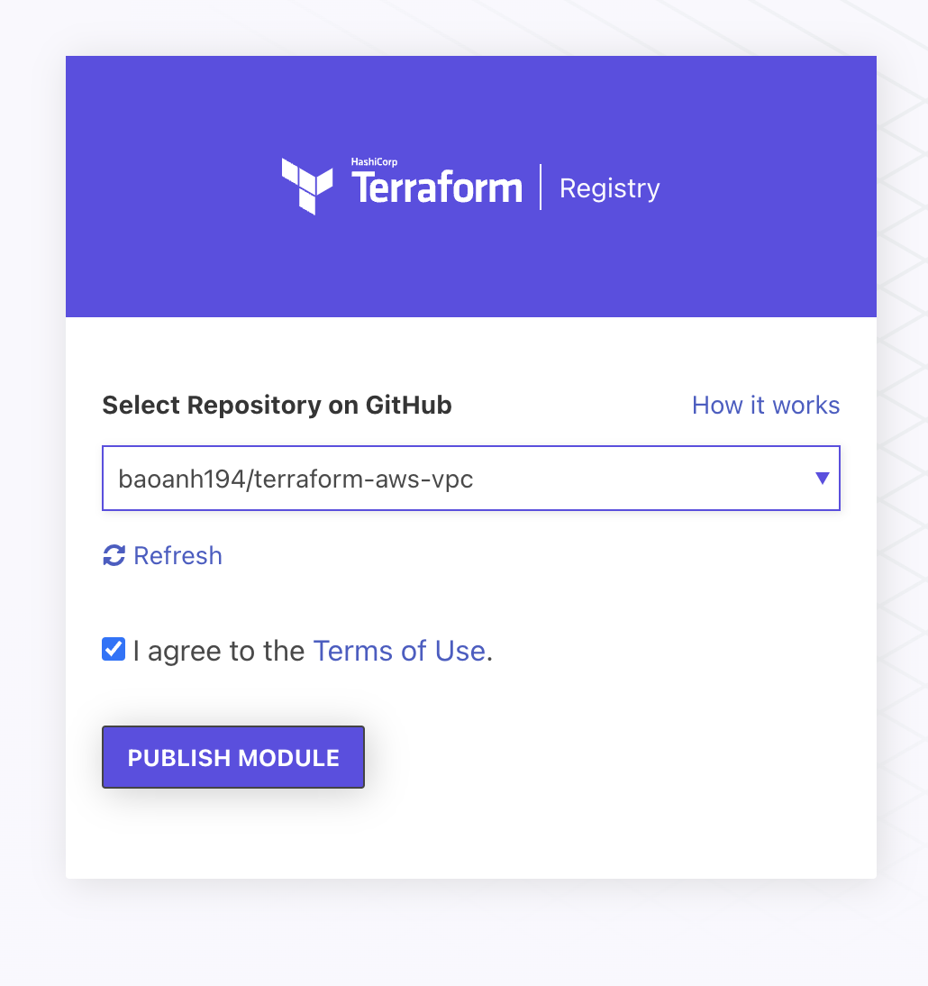

Slide 43
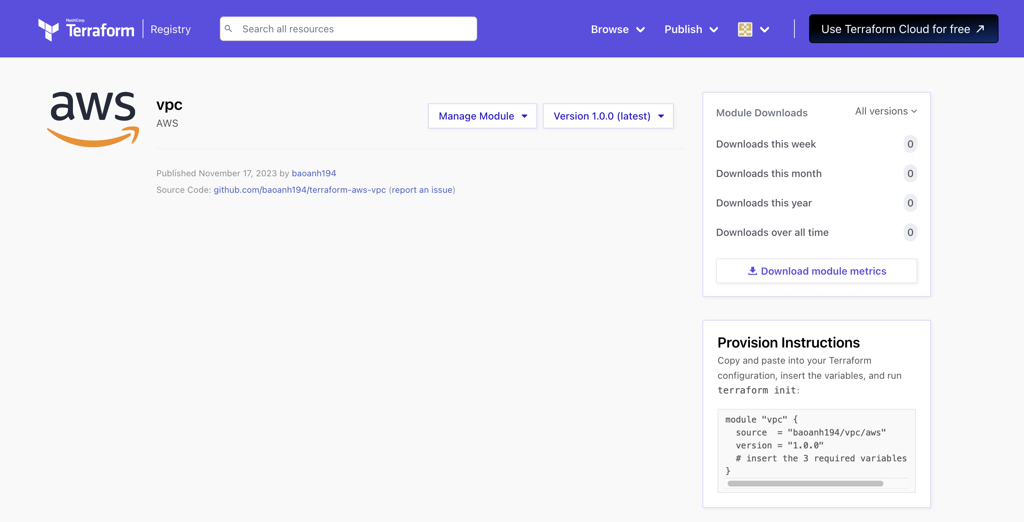
Our module is published successful

Slide 44

Summary
We have learned how to write code from scratch and then organize the code into Modules,
how to Publish a Module online, and how to use existing Modules.
Modules help us use existing code and avoid having to write code over and over again.
When working on important projects, it's smart to use ready-made modules created by experienced developers.
These modules, like terraform-aws-modules/vpc/aws, are well-crafted, cover more situations,
and are more reliable than what we might create ourselves.

Slide 45

THE END

Slide 46
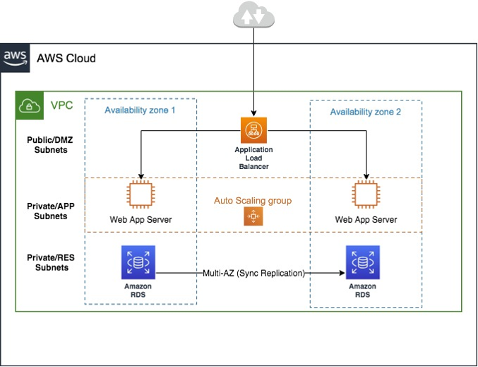
What’s next on part 3?
Create Multiotier Web Application with Terraform

Slide 47

Q&A
Notes:
https://someguys.blog/posts/2017-04-26-recovering-terraform-state/
https://medium.com/version-1/recovering-from-a-deleted-terraform-state-file-5e030c88aae0

